Slide 1
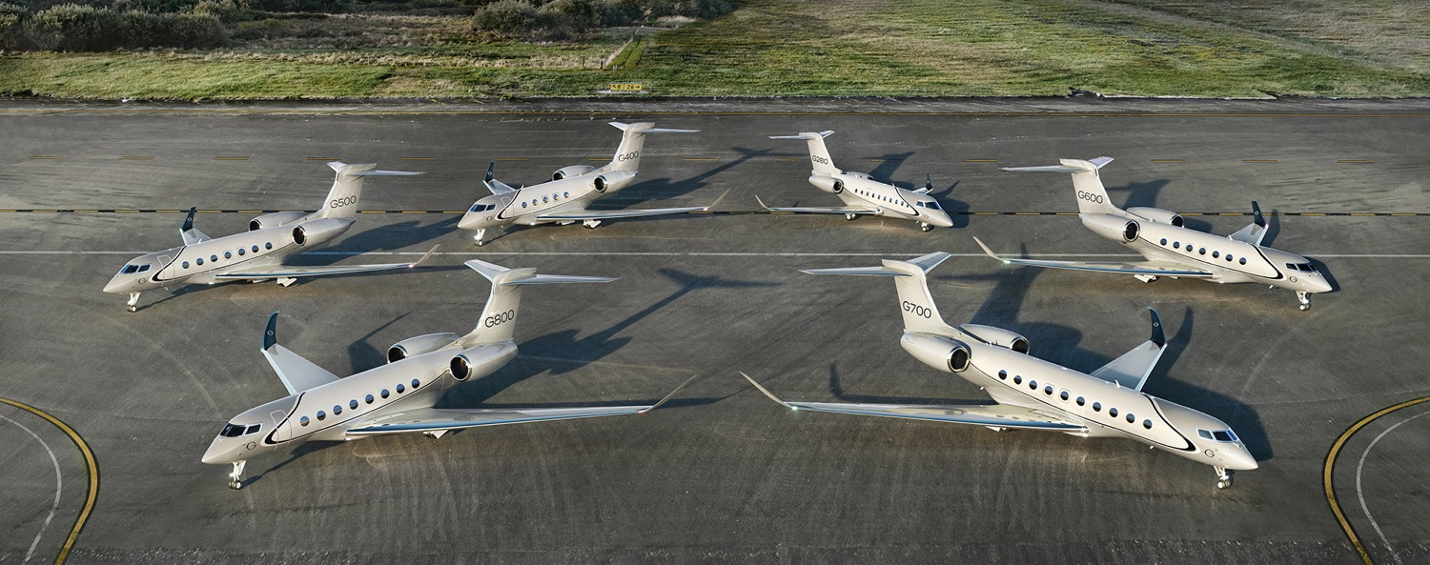
Product Line Overview
June 2025

Slide 2
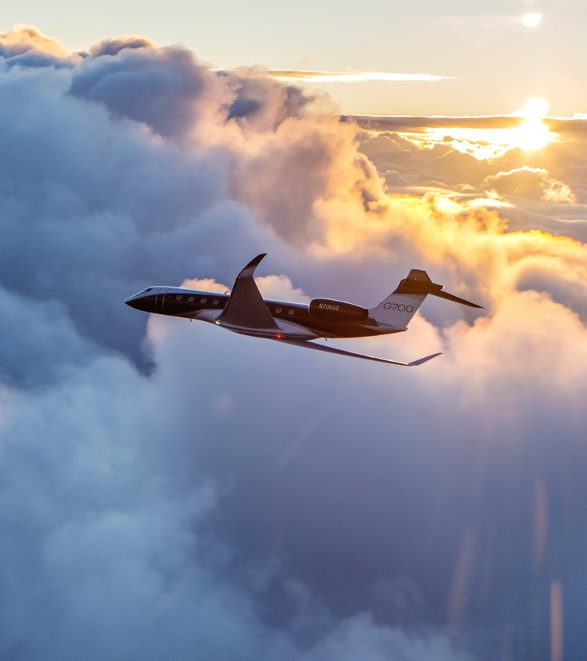
Strength of Gulfstream
Leading the industry with more than a decade of investments
Advanced technology
Precision manufacturing
Unmatched cabin experience
Outstanding customer support
Introduced the most formidable fleet of new, high-technology aircraft

Slide 3
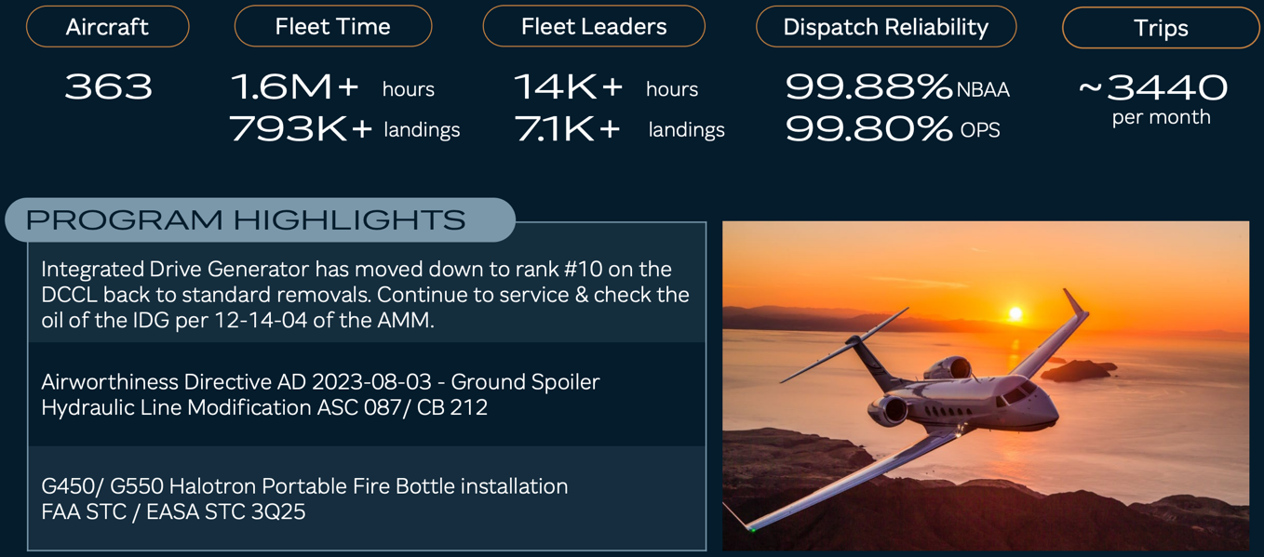
G450 FLEET UPDATE

Slide 4
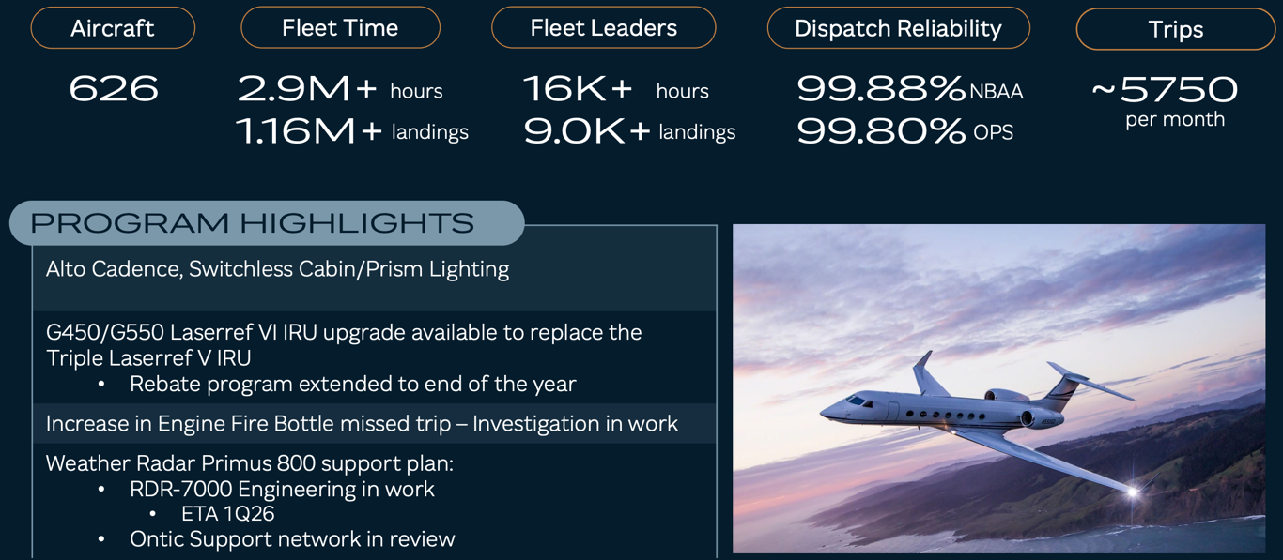
G550 FLEET UPDATE

Slide 5
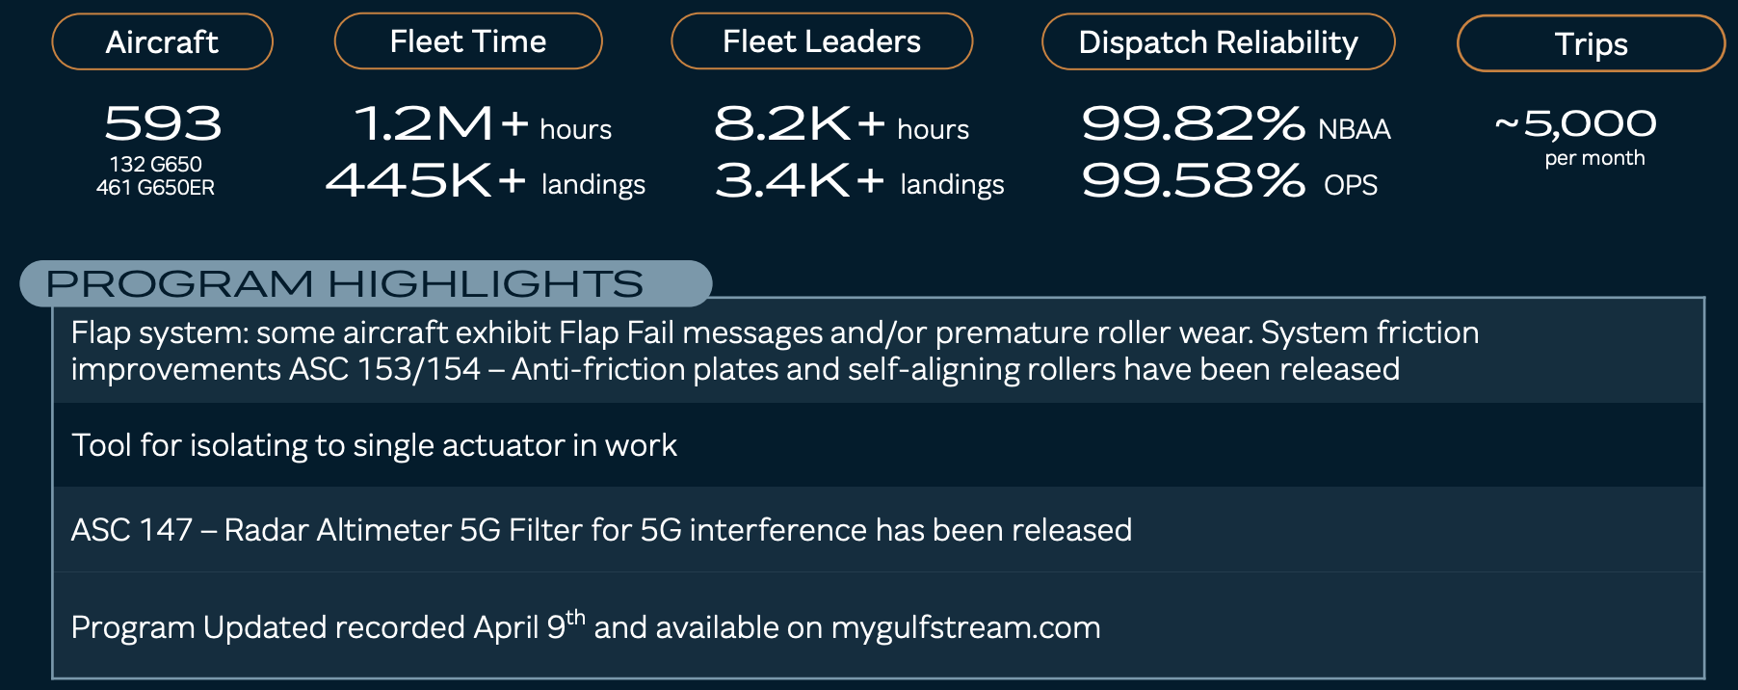
G650 AND G650ER FLEET UPDATE

Slide 6
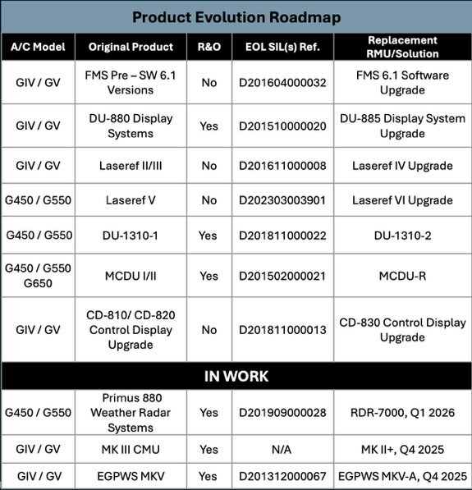
Managing Obsolescence
As products age, component obsolescence becomes an increasing challenge
Component OEMs reduce their capacity to provide spares, and repair and overhaul services
Gulfstream has expanded its capacity to provide these services internally
Product updates and available spares / overhaul capability help maintain the fleet’s overall value as aircraft age

Slide 7

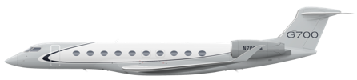
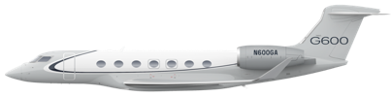




A Gulfstream for Every Mission
G800
8,200 nm Mach 0.85
G700
7,750 nm Mach 0.85
G600
6,600 nm Mach 0.85
G500
5,300 nm Mach 0.85
G400
4,200 nm Mach 0.85
….building on the company’s decades-long investment
in research and development and ensuing successes
- Mark Burns President, Gulfstream
G280
3,600 nm Mach 0.80
Notes:
Today, Gulfstream has the most formidable fleet of aircraft in the industry.
A Gulfstream for every mission – each aircraft setting a new standard for our industry in terms of safety, high-speed performance, environmental efficiency, and an unmatched cabin experience.
This fleet of aircraft is only possible through significant investments in:
Precision Manufacturing
Advanced Safety Technologies
Unmatched Cabin Experience
World Class Customer Support

Slide 8
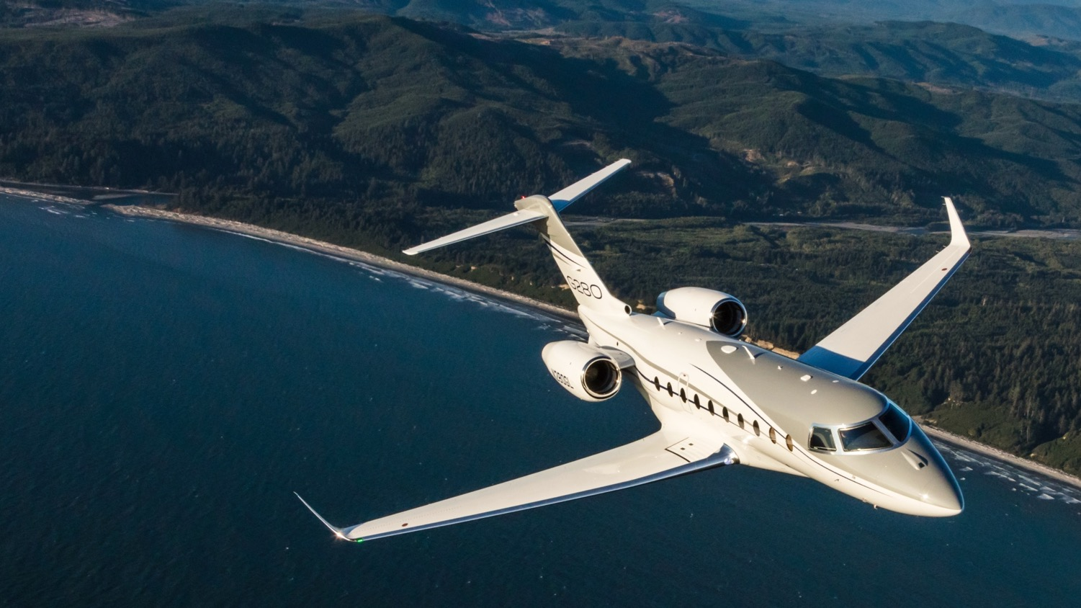

Gulfstream G280
"Gulfstream takes the super mid-sized category to a new flight level" –Forbes
300 Aircraft in Service
12 Month Dispatch Reliability of 99.88% (NBAA)
Fleet Time Fleet Leader | 575,200+ hrs 6,500+ hrs
Fleet Landings Fleet Leader | 357,700+ 5,505+
Notes:
Updated from the June 3rd Operators Forum in Santa Clara Mid-cabin Update

Slide 9
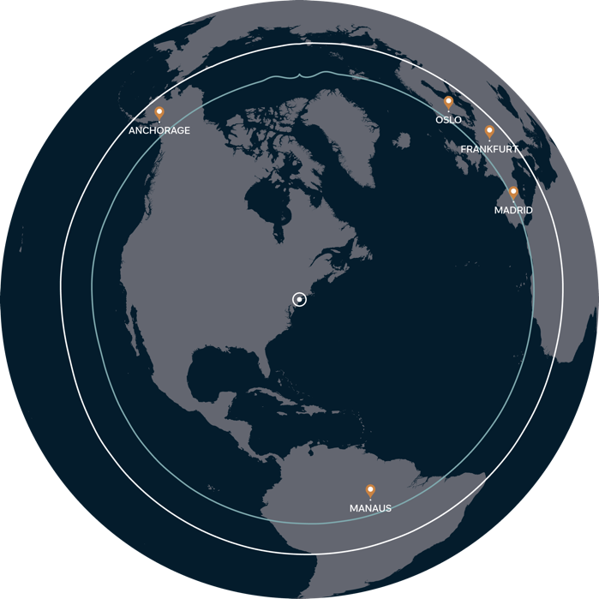
Gulfstream G280
Maximum range departing new york
New York
M0.84
M0.80

Slide 10
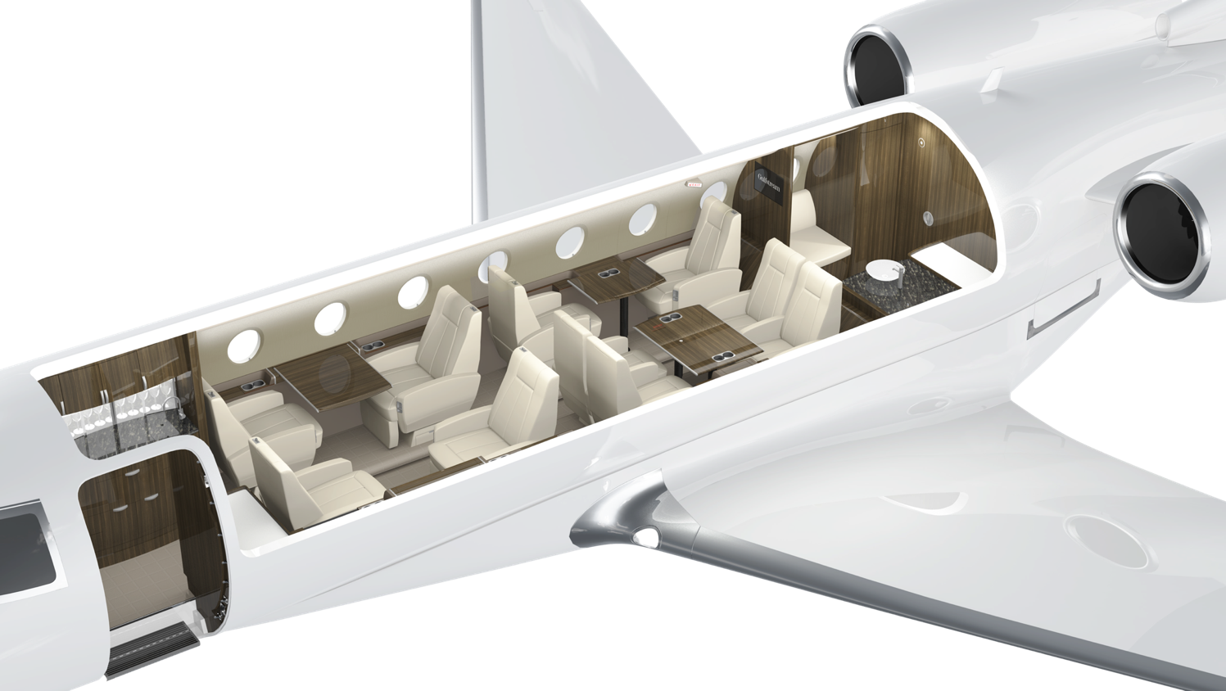
G280 Cabin
Seating for 8 to 10 passengers
2 seating areas

Slide 11
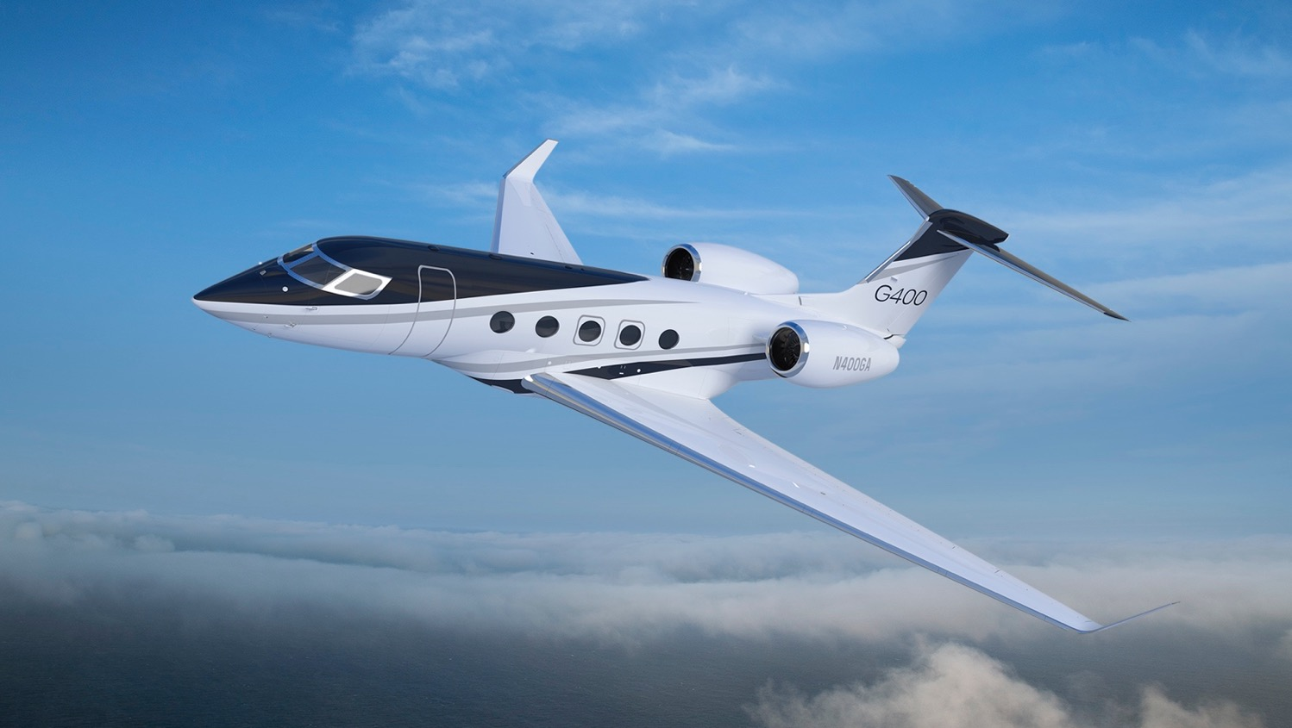
The all-new gulfstream g400
Next-generation
Pratt & Whitney engines
Advanced high-speed
wing and winglet
Common flight deck among
G400, G500, G600, G700 and G800
Long range at high speed
4,200 nm (7,778 km) at Mach 0.85
Long range at fastest speed
3,950 nm (7,315 km) at Mach 0.88
Flight test campaign proceeding very well.
Anticipated entry into service 2027.
Healthy Cabin Environment
100% fresh, low cabin noise and abundant natural light provide a healthy and relaxing cabin
NBAA range with 8 passengers, 3 crew, NBAA IFR reserves. Actual performance will be affected by ATC routing, operating speed, weather, outfitting options and other factors.
G400 performance is preliminary and subject to change.
Notes:
On that topic, I’d like to express that the G400 is part of our family of next generation aircraft – G400, G800
Winglet: Industry leading for speed and aerodynamic efficiency
Largest cabin in its class – comfortably seating up to 12 pax
It features the same symmetry flight deck in the G500, G600, G700 and G800
Features active control sidesticks and touch screen control
Flight test campaign is proceeding very well...

Slide 12
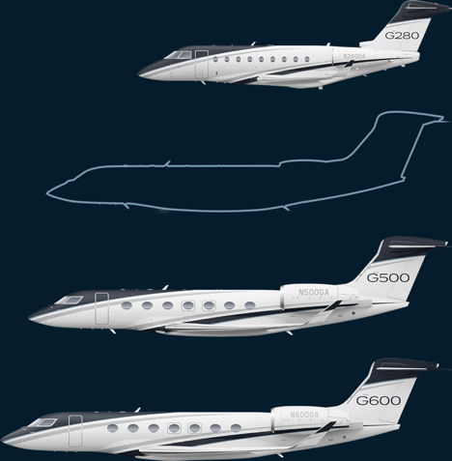
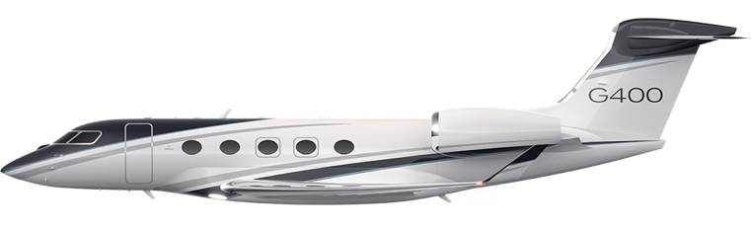
Gulfstream fleet addition
Gulfstream is the first OEM to introduce a new product in the large-cabin segment in more than a decade
Notes:
Now, to further clarify my title regarding the technical evolution of our fleet, I’d like to express that the G400 is not replacing a product, it’s a new product
It benefits from the in-service experience of over 300 G500 and G600 aircraft which have the same type rating, and we’re aiming for the G400 to have that also.
Hope to certify in 2027

Slide 13
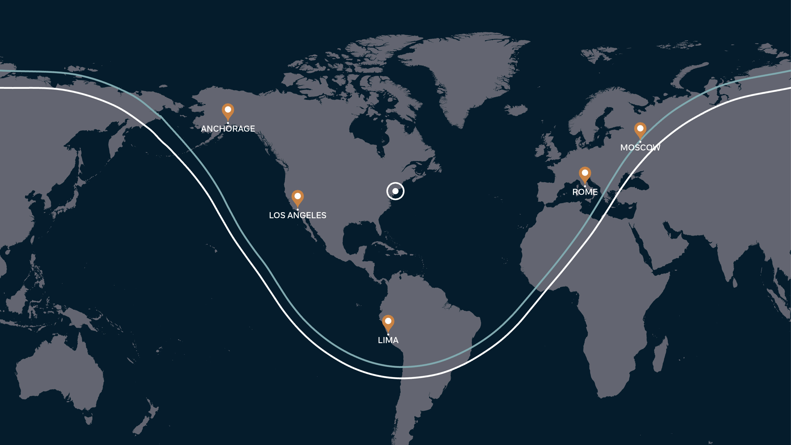
Gulfstream G400
Maximum range departing New York
New York
M0.88
M0.85
NBAA IFR theoretical range with 8 passengers, 4 crew and 85% annual winds.
Actual range will be affected by ATC routing, operating speed, weather, outfitting options and other factors.
G400 data is preliminary and subject to change.

Slide 14
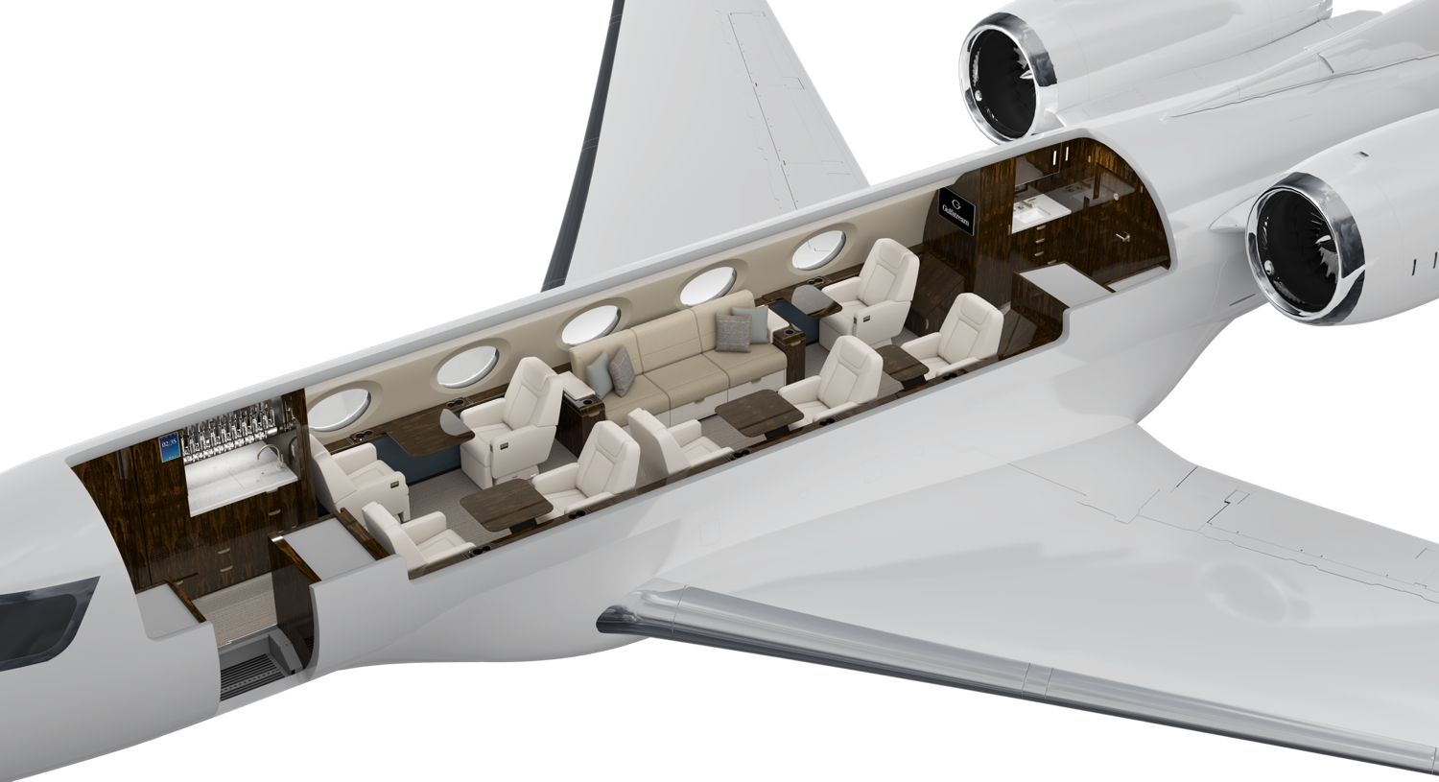
G400 Cabin
2 ½ seating areas

Slide 15
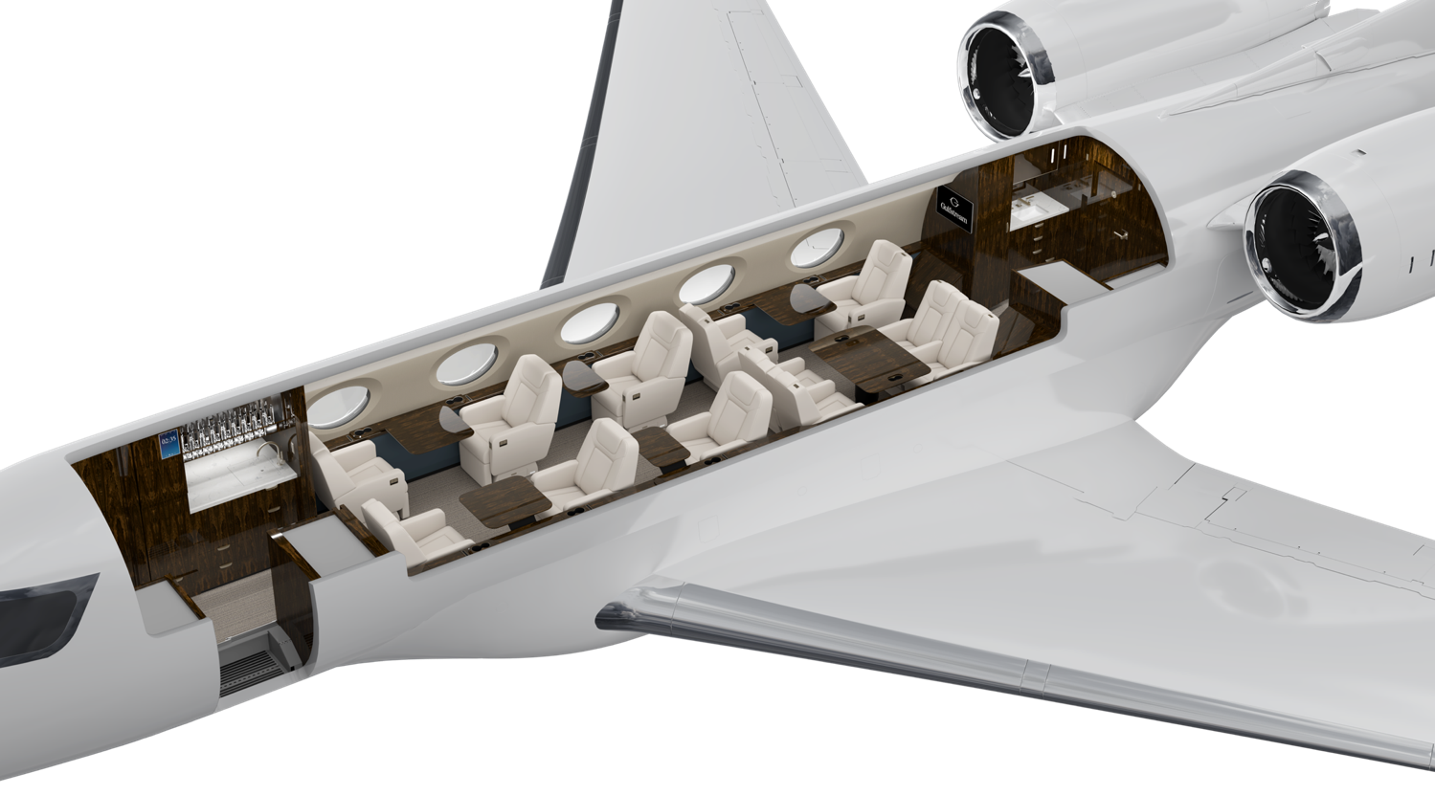
G400 Cabin
2 ½ seating areas

Slide 16
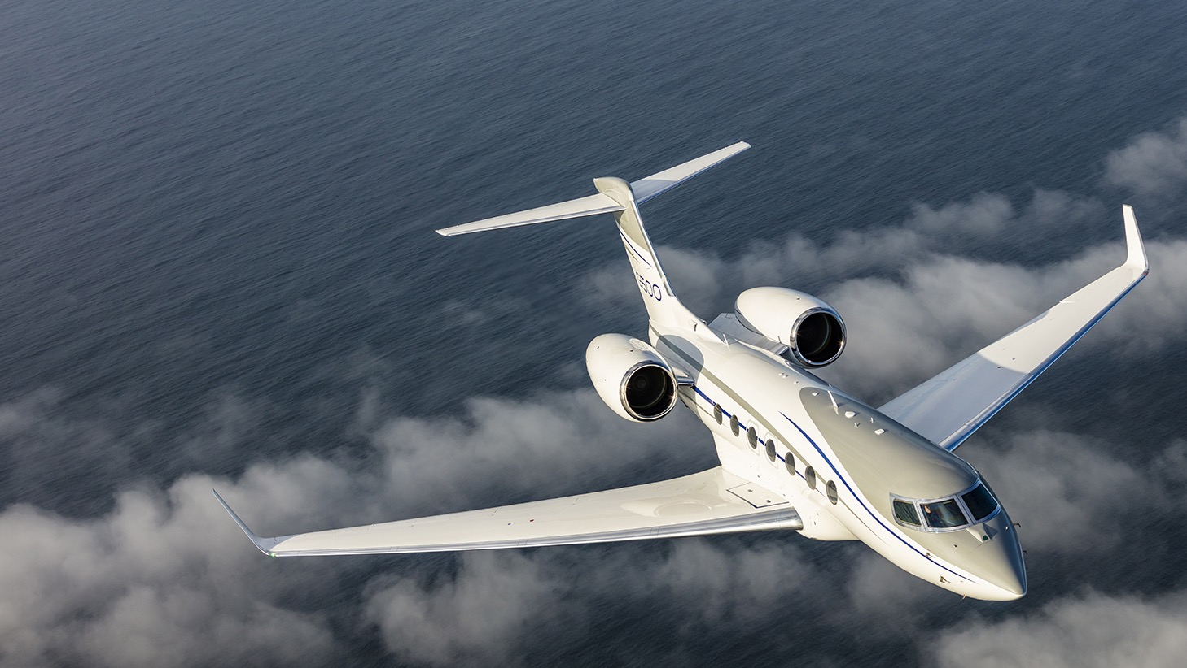
Gulfstream G500
“The G500 represents a new generation of innovation in the business-jet industry.”
Flying magazine
158 Aircraft in Service
12 Month Dispatch Reliability of 99.88% (NBAA). 99.68% (Gulfstream)
Fleet Time Fleet Leaders | 145,100+ hrs 2,900+ hrs
Fleet Landings Fleet Leaders | 76,700+ 2,510+
Notes:
Updated from the June 3rd 2025 Operators Forum

Slide 17
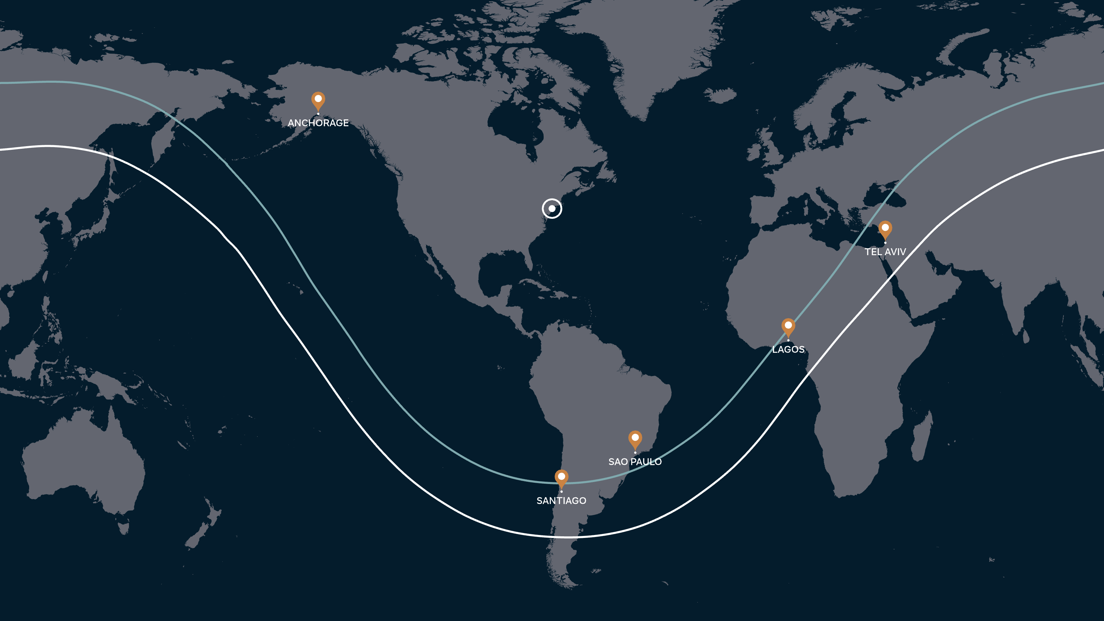
Gulfstream G500
Maximum range departing new york
New york
M0.85
M0.90
NBAA IFR theoretical range with 8 passengers, 3 crew and 85% annual winds.
Actual range will be affected by ATC routing, operating speed, weather, outfitting options and other factors.

Slide 18
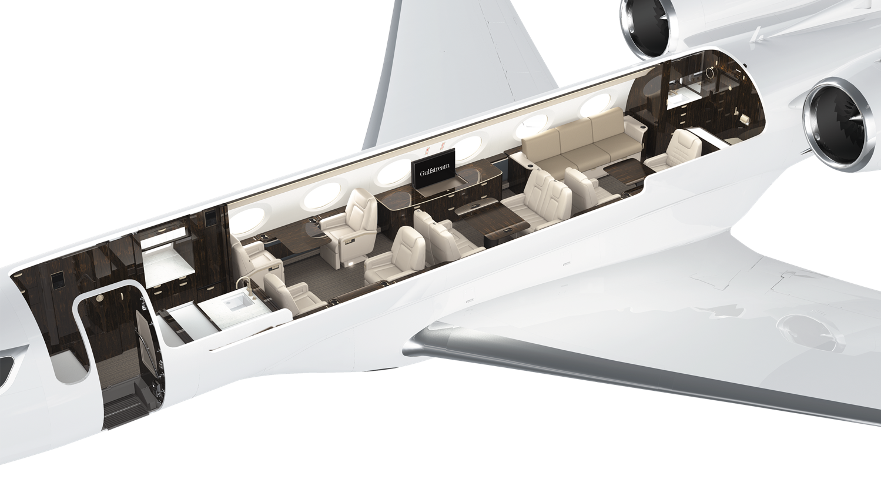
G500 Cabin
3 Seating areas

Slide 19
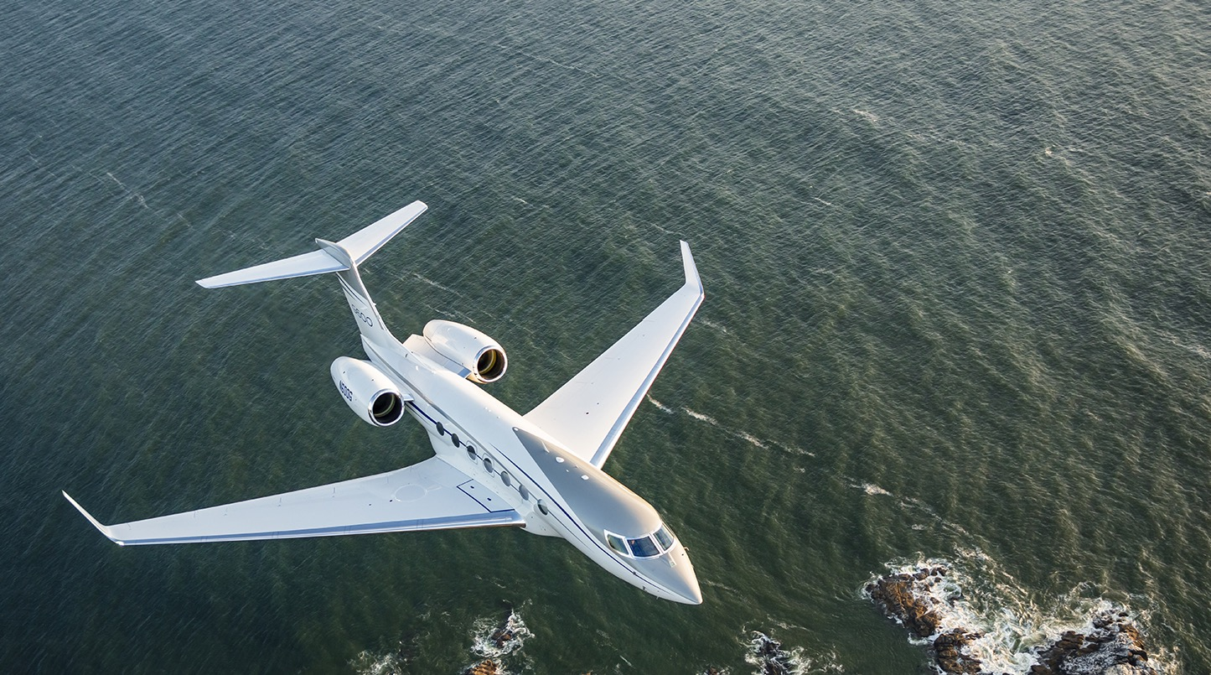
Gulfstream G600
The G600 is the market-leader in speed, range and efficiency with the segments most advanced technology
170 Aircraft in Service
12 Month Dispatch Reliability of 99.85% (NBAA). 99.68% Gulfstream
Fleet Time Fleet Leaders | 154,300+ hrs 2,685+ hrs
Fleet Landings Fleet Leaders | 69,100+ 1800+
Notes:
Updated from the June 3rd 2025 Operators Forum

Slide 20
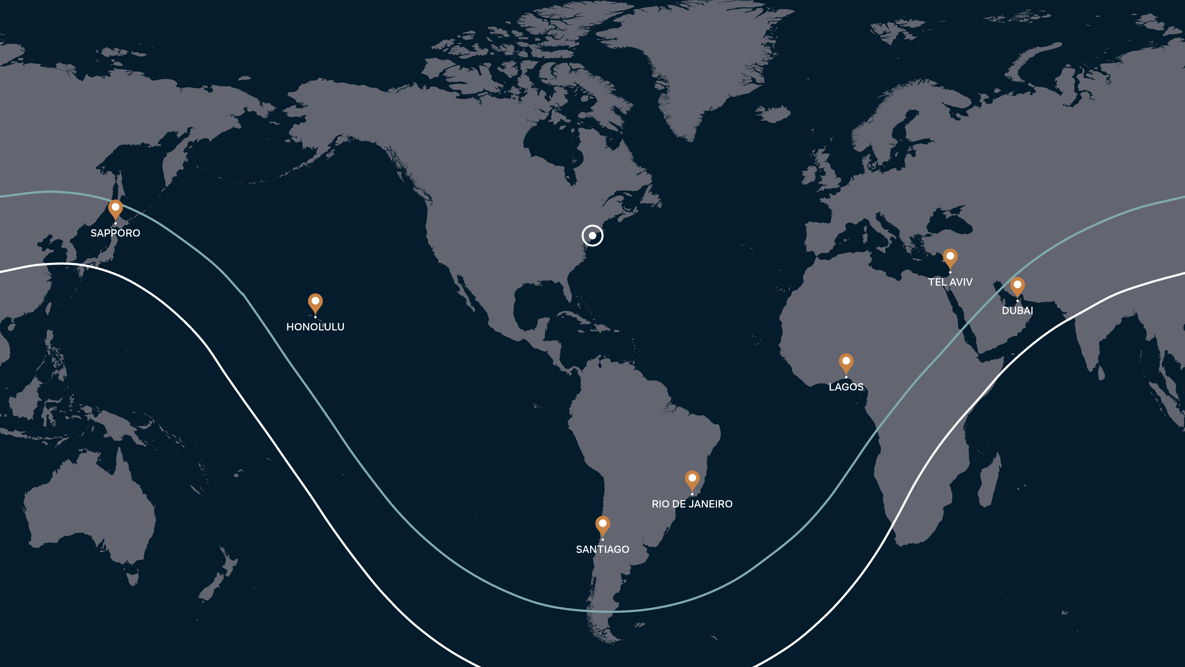
Gulfstream G600
Maximum range departing new York
New York
M0.85
M0.90
NBAA IFR theoretical range with 8 passengers, 4 crew and 85% annual winds.
Actual range will be affected by ATC routing, operating speed, weather, outfitting options and other factors.

Slide 21
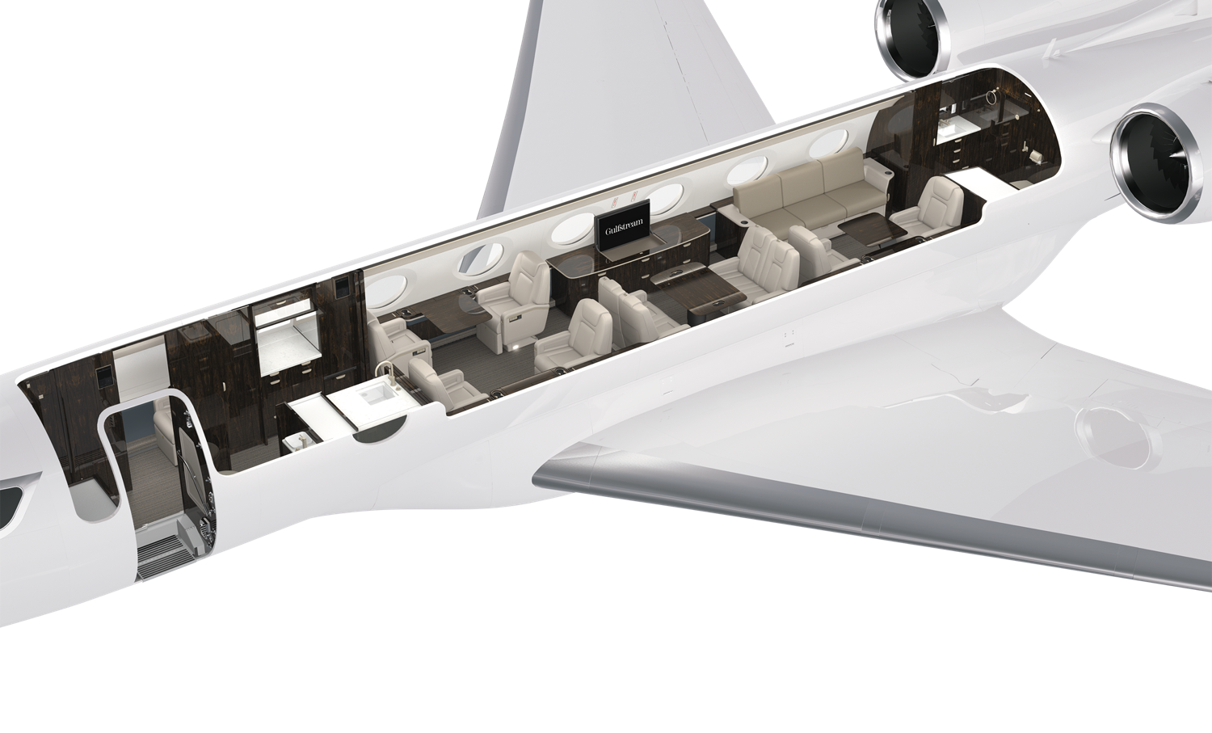
G600 Cabin
3 Seating areas with crew rest

Slide 22
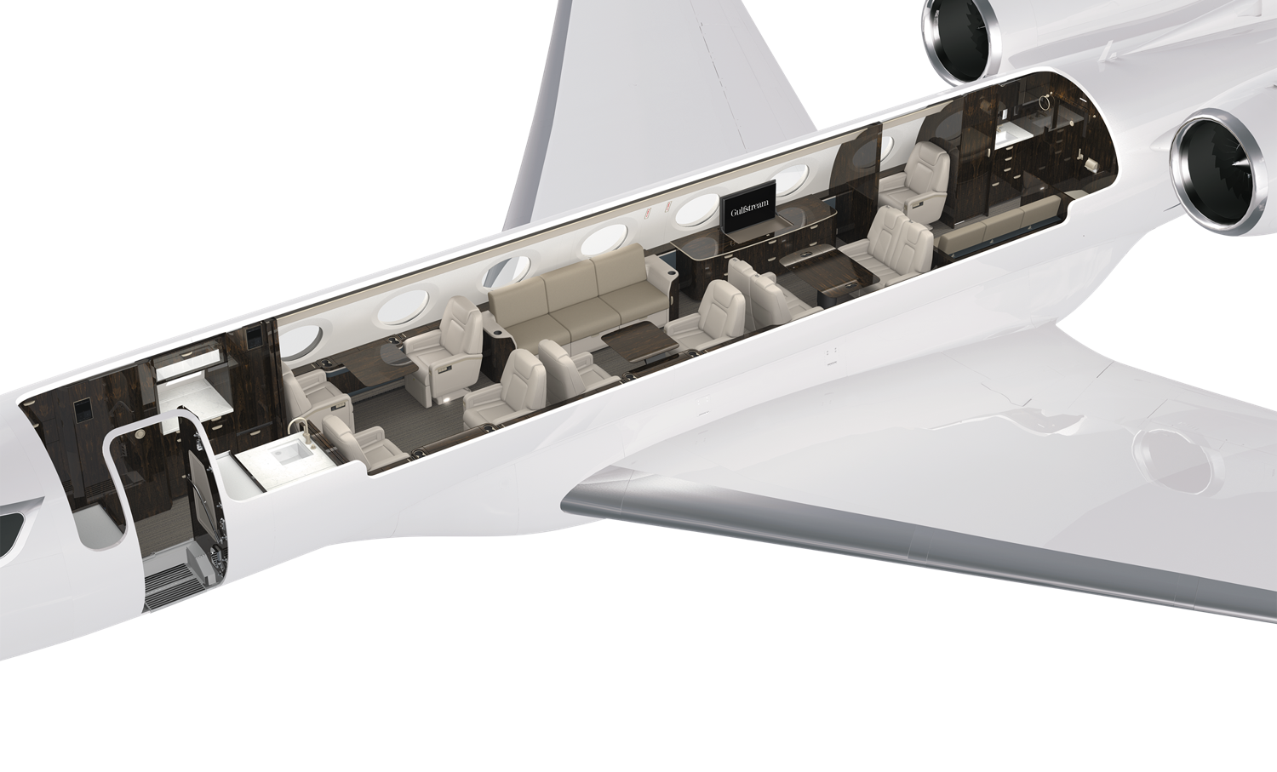
G600 Cabin
4 seating areas without crew area

Slide 23
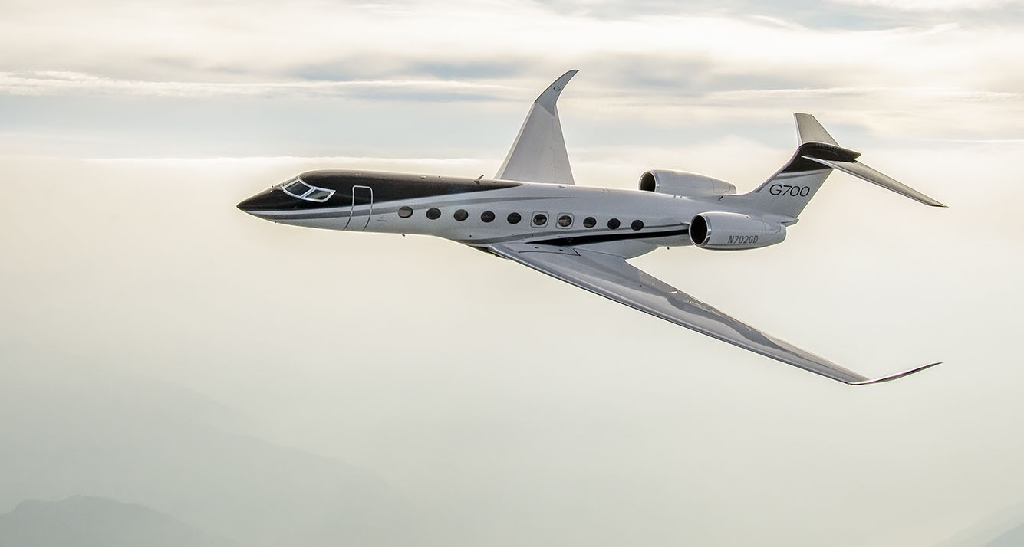
Gulfstream G700
Holder of over 80 World City-Pair Speed Records
Entered service 2024
50 Aircraft in Service at the end of 1Q 2025
Fleet Time Fleet Leaders | 12,300+ hrs 1,150+ hrs
Fleet Landings Fleet Leaders | 4,300+ 390+
Combining high-speed efficiency with unmatched comfort, the G700 sets a new standard.
The G700 will continuing Gulfstream’s leadership with the largest and most comfortable cabin with the latest Symmetry flight.
Notes:
Updated from the May 8th Operators Forum in Singapore G700 Update Event Presentation

Slide 24
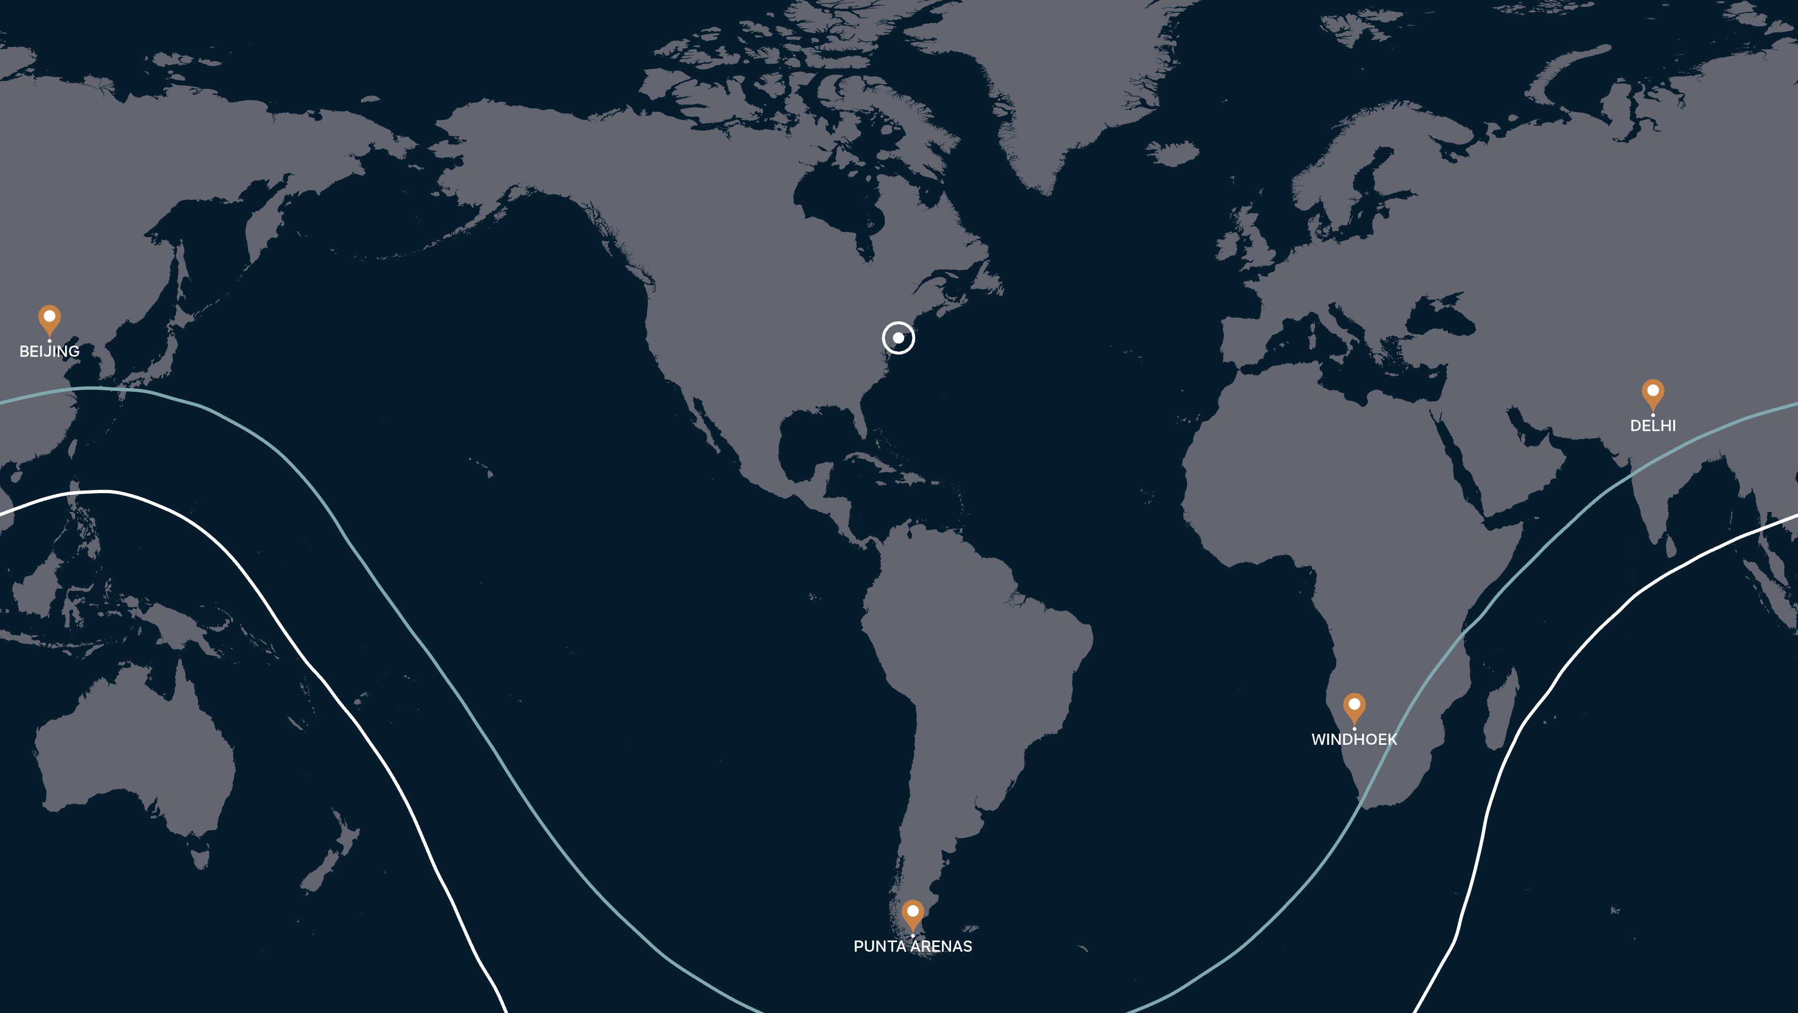
Gulfstream G700
Maximum range departing New York
New York
M0.90
M0.85
NBAA IFR theoretical range with 8 passengers, 4 crew and 85% annual winds.
Actual range will be affected by ATC routing, operating speed, weather, outfitting options and other factors.

Slide 25
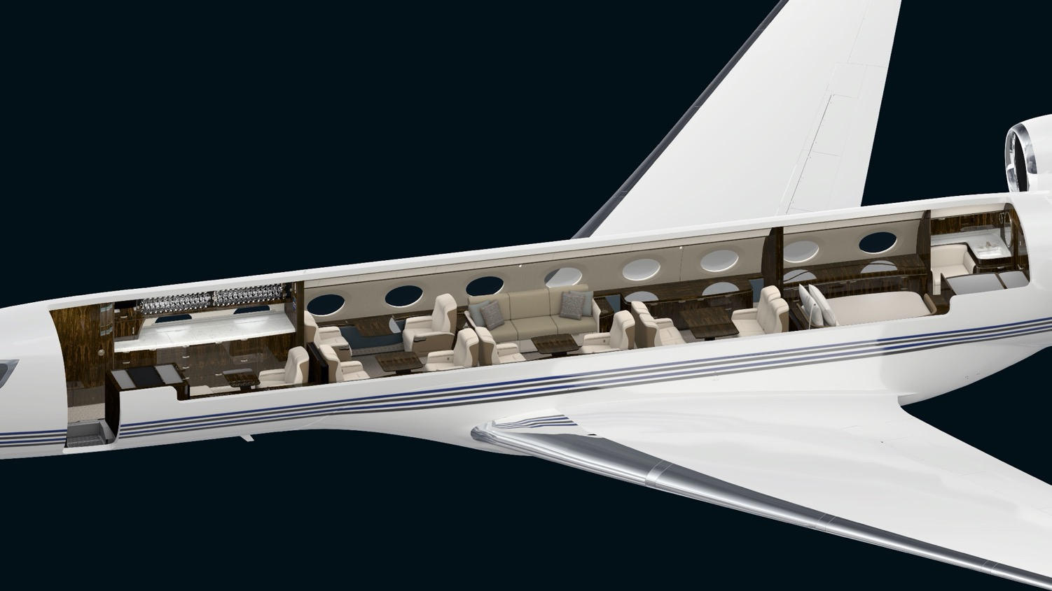
G700 Cabin
4 seating areas with crew area

Slide 26
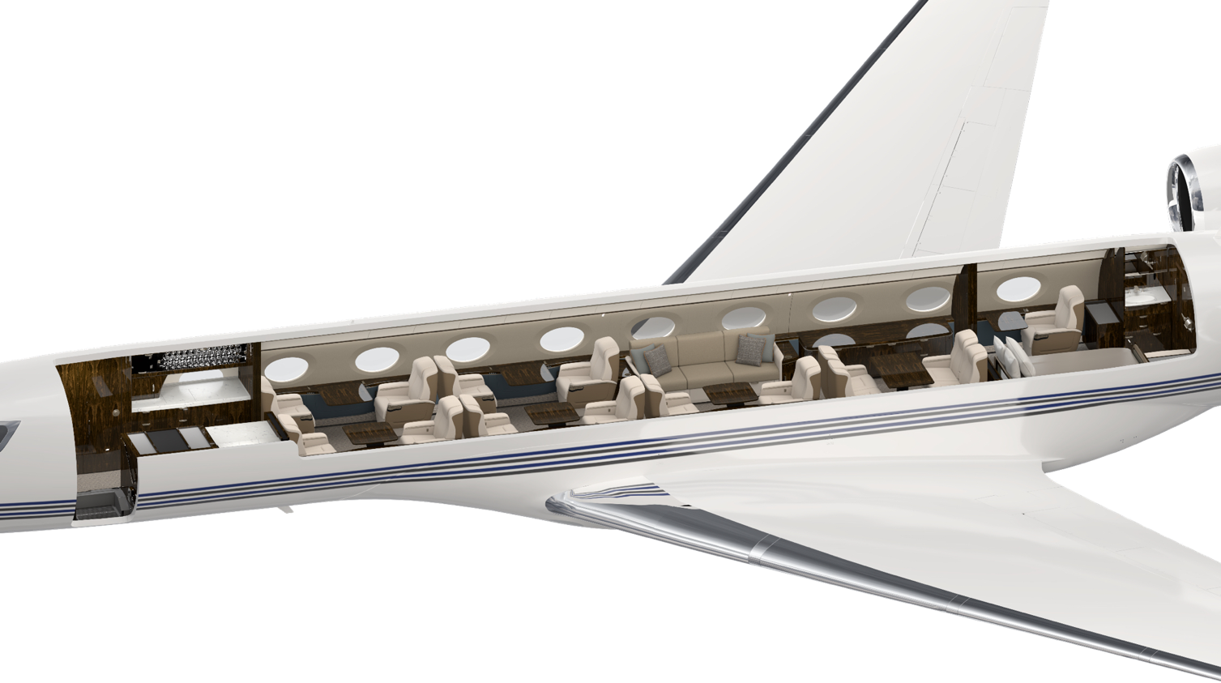
G700 Cabin
5 seating areas without crew rest

Slide 27
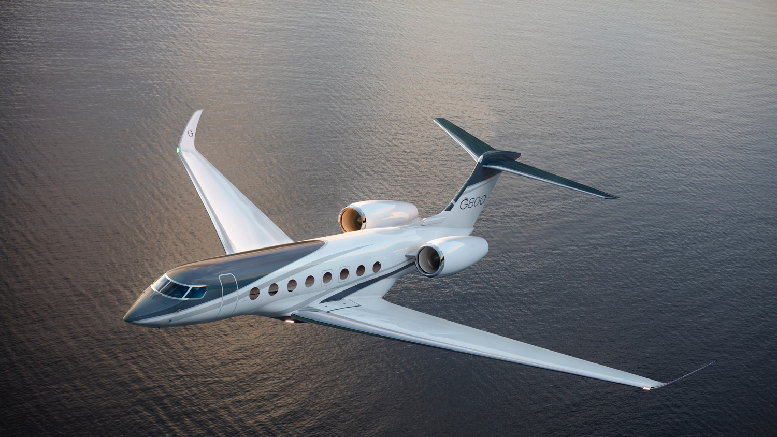
All-New Gulfstream G800
Introducing the fastest, longest-range Gulfstream ever designed
FAA and EASA Certified in April 2025
Notes:
And then finally, we have the highly anticipated G800, who’s flight testing and certification is nearing completion

Slide 28
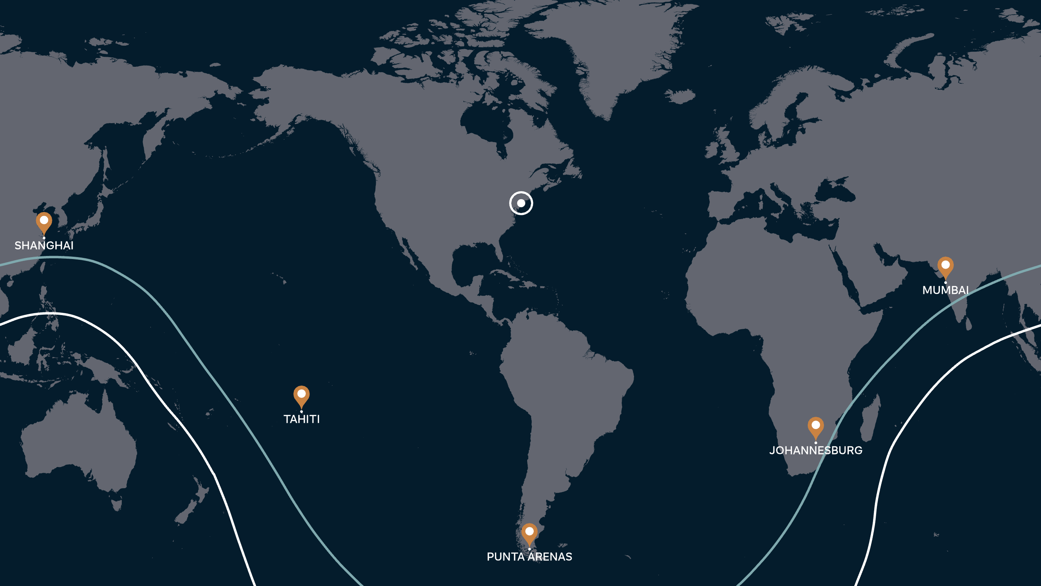
Gulfstream G800
Maximum range departing New York
New York
M0.90
M0.85
NBAA IFR theoretical range with 8 passengers, 4 crew and 85% annual winds.
Actual range will be affected by ATC routing, operating speed, weather, outfitting options and other factors.

Slide 29
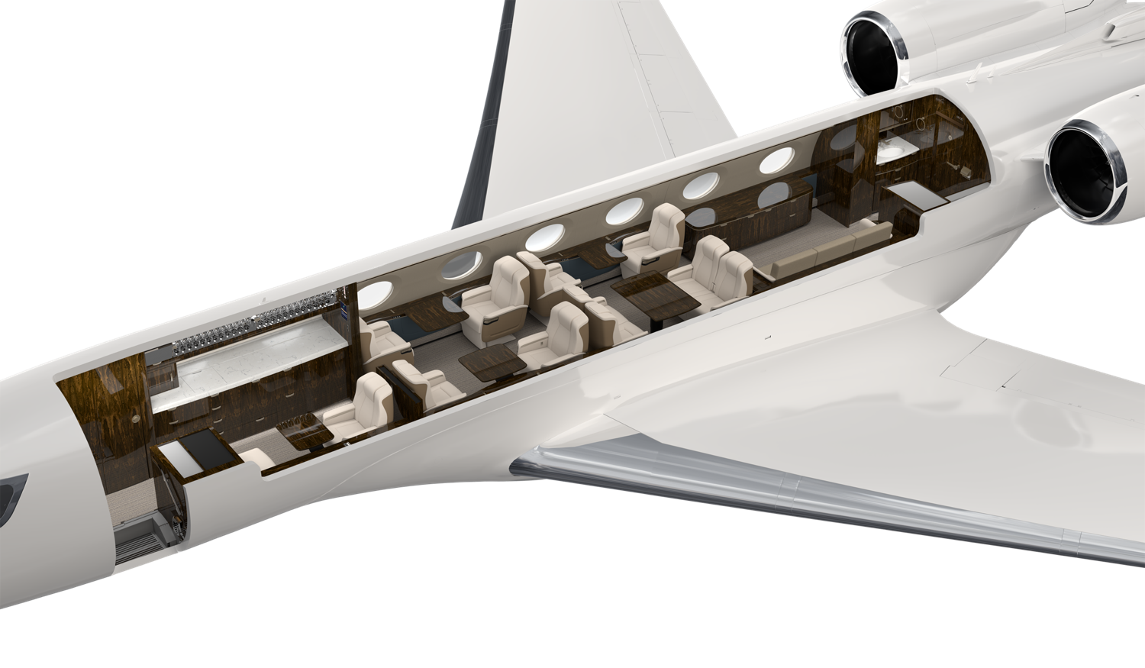
G800 Cabin
3 Seating areas with crew rest

Slide 30
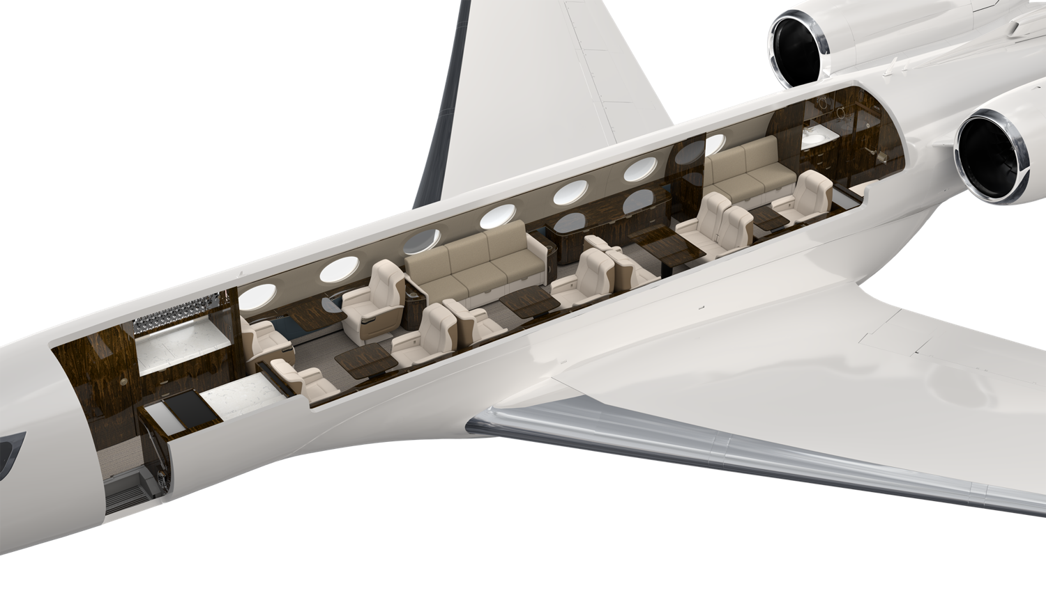
G800 Cabin
4 Seating areas without crew rest

Slide 31
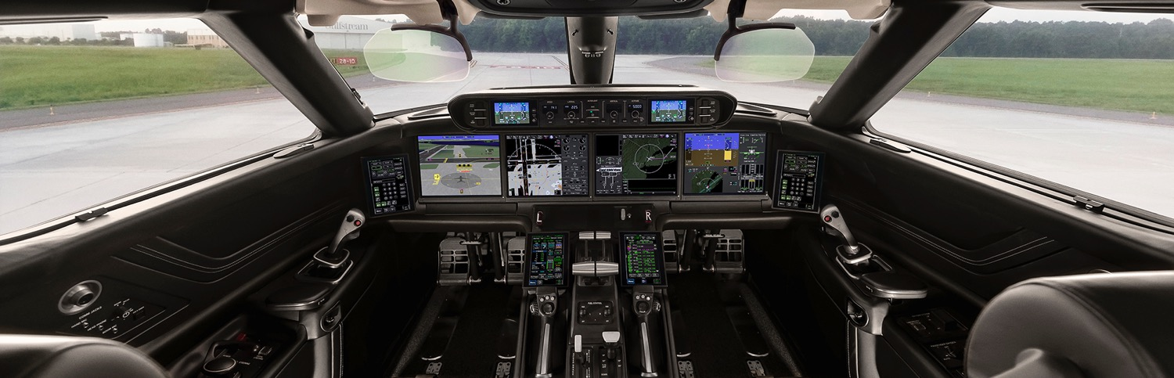
GULFSTREAM LEADERSHIP
IN INNOVATION AND SAFETY

Slide 32
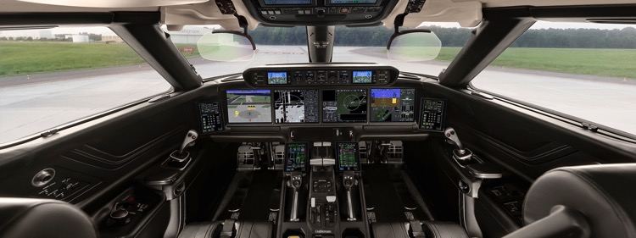

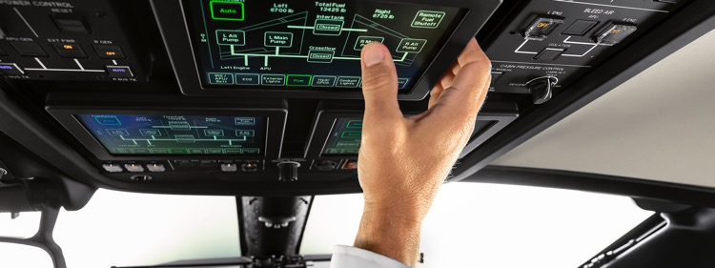
Symmetry,
SAFETY ENHANCING, ADVANCED flight deck technology
10 Touch Screen Interfaces with intuitive
phase of flight
  Streamlines the interface with the flight deck by dramatically reducing the number of switches
Active Control Sidesticks
  Simulation of mechanically linked sticks prevents simultaneous pilot input
Data Concentration Network
  Increased data access for health trend monitoring, reduced electro-mechanical devices and wiring
Common in the G400, G500, G600, G700 and G800.

Slide 33



Enhanced Vision System
Significantly improves situational awareness and enhances safety in reduced visibility conditions (fog, haze, smoke,
night-time)
  Fully integrated with flight deck and LCD head up display
  Cryogenically cooled IR sensor offers more sensitivity and better performance
System performance now allows for
all-new EVS to land capability
No EVS
No EVS
*Optional Feature on G280/G400
EVS

Slide 34
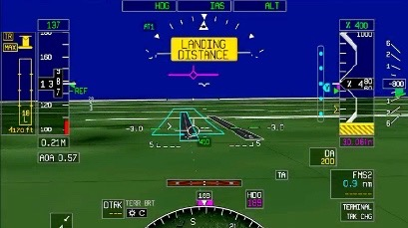
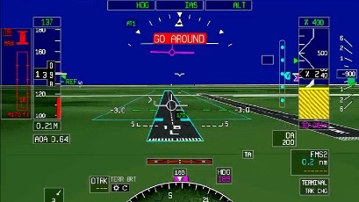
Predictive landing performance system
Another Gulfstream industry first
Enhances safety on approach and landing with continuous display of stopping point
Based on calculated aircraft performance
Provides aural and visual alerts for recommended pilot action to manage aircraft energy
Displays stopping point relative to runway threshold
Visual alerts provided on HUD and PFD

Slide 35
Specification Comparison
 | G280 | G400 | G500 | G600 | G700 | G800
Exterior Length | 66 ft 10 in 20.37 m | 86 ft 3 in 26.29 m | 91 ft 2 in 27.79 m | 96 ft 1 in 29.29 m | 109 ft 10 in 33.48 m | 99 ft 9 in 30.40 m
Exterior Height | 21 ft 4 in 6.50 m | 25 ft 4 in 7.72 m | 25 ft 6 in 7.77 m | 25 ft 3 in 7.70 m | 25 ft 5 in 7.75 m | 25 ft 6 in 7.77 m
Wingspan | 63 ft 0 in 19.20 m | 86 ft 4 in 26.31 m | 86 ft 4 in 26.31 m | 94 ft 2 in 28.70 m | 103 ft 0 in 31.39 | 103 ft 0 in 31.39
Maximum Ramp Weight | 39,750 lb 18,030 kg | 70,250 lb 31,865 kg | 80,000 lb 36,287 kg | 95,000 lb 43,091 kg | 108,000 lb 48,988 kg | 106,000 lb 48,081kg
Maximum Takeoff Weight | 39,600 lb 17,962 kg | 69,850 lb 31,683 kg | 79,600 lb 36,106 kg | 94,600 lb 42,910 kg | 107,600 lb 48,807 kg | 105,600 lb 47,899 kg
Maximum Landing Weight | 32,700 lb 14,832 kg | 60,000 lb 27,216 kg | 64,350 lb 29,189 kg | 76,800 lb 34,836 kg | 83,500 lb 37,875 kg | 83,500 lb 37,875 kg
Maximum Fuel Weight | 14,600 lb 6,622 kg | 25,350 lb 11,499 kg | 30,250 lb 13,721 kg | 41,500 lb 18,824 kg | 49,400 lb 22,407 kg | 49,400 lb 22,407 kg
Maximum Payload | 4,050 lb 1,837 kg | 4,050 lb 1,837 kg | 5,205 lb 2,381 kg | 6,540 lb 2,966 kg | 6,385 lb 2,896 kg | 6,200 lb 2,812 kg
Maximum Payload with Full Fuel | 1,000 lb 454 kg | 1,800 lb 816 kg | 2,900 lb 1,315 kg | 2,600 lb 1,179 kg | 2,235 lb 1,014 kg | 2,300 lb 1,043 kg
All specifications at spec. operating weight. G400 data is preliminary and subject to change.

Slide 36
Performance Comparison
 | G280 | G400 | G500 | G600 | G700 | G800
Long Range Cruise Speed | Mach 0.80 | Mach 0.85 | Mach 0.85 | Mach 0.85 | Mach 0.85 | Mach 0.85
High Speed Cruise Speed | Mach 0.84 | Mach 0.88 | Mach 0.90 | Mach 0.90 | Mach 0.90 | Mach 0.90
MMO Mach | 0.850 | 0.900 | 0.925 | 0.925 | 0.935 | 0.935
Range at Long Range Cruise | 3,600 nm 6,667 km | 4,200 nm 7,778 km | 5,300 nm 9,816 km | 6,600 nm 12,223 km | 7,750 nm 14,353 km | 8,200 nm 15,186 km
Range at High-Speed Range Cruise | 3,000 nm 5,556 km | 3,950 nm 7,315 km | 4,500 nm 8,334 km | 5,600 nm 10,371 km | 6,650 nm 12,316 km | 7,000 nm 12,964 km
Initial Cruise Altitude | FL430 13,106 m | FL410 12,497 m | FL430 13,106 m | FL410 12,497 m | FL410 12,497 m | FL410 12,497 m
Maximum Altitude | FL450 13,716 m | FL510 15,545 m | FL510 15,545 m | FL510 15,545 m | FL510 15,545 m | FL510 15,545 m
Takeoff Distance SL, ISA, MTOW, Dry | 4,750 ft 1,448 m | 5,000 ft 1,524 m | 5,300 ft 1,615 m | 5,700 ft 1,737 m | 6,250 ft 1,905 m | 6,000 ft 1,829 m
Landing Distance SL, ISA, MLW, Dry | 2,720 ft 829 m | 3,000 ft 914 m | 3,100 ft 945 m | 2,900 ft 884 m | 3,250 ft 991 m | 3,250 ft 991 m
NBAA IFR theoretical range with 4 passengers for G280 and 8 passengers for all others, 85% annual winds. Actual range will be affected by ATC routing, operating speed, weather, outfitting options and other factors. G400 data is preliminary and subject to change.

Slide 37
Technology and Systems Comparison
 | G280 | G400 | G500 | G600 | G700 | G800
Flight Deck | PlaneView280 | Symmetry | Symmetry | Symmetry | Symmetry | Symmetry
Engine | Honeywell HTF7250G | PWC PW812 | PWC PW814 | PWC PW815 | RR Pearl 700 | RR Pearl 700
Thrust Rating (each) | 7,624 lb 33.9 kN | 13,486 lb 60.0 kN | 15,144 lb 67.4 kN | 15,680 lb 69.7 kN | 18,250 lb 81.2 kN | 18,250 lb 81.2 kN
Takeoff Thrust-to-Weight | 0.385 | 0.386 | 0.381 | 0.332 | 0.339 | 0.346
Flight Controls | Fly-by-wire / Mechanical Mix w/Yoke | Fly-by-wire w / Active Sidesticks | Fly-by-wire w / Active Sidesticks | Fly-by-wire w / Active Sidesticks | Fly-by-wire w / Active Sidesticks | Fly-by-wire w / Active Sidesticks
HUD with EVS | Single HUD Optional | Single HUD Optional | Single HUD Standard | Single HUD Standard | Dual HUD Standard | Dual HUD Standard
Synthetic Vision | Optional | Optional | Standard | Standard | Standard | Standard
Automatic Braking System | Standard | Standard | Standard | Standard | Standard | Standard
G400 data is preliminary and subject to change

Slide 38
Cabin Comparison
 | G280 | G400 | G500 | G600 | G700 | G800
Total Interior Length (Cockpit divider to aft pressure bulkhead) | 32 ft 3 in 9.83 m | 42 ft 5 in 12.93 m | 47 ft 7 in 14.50 m | 51 ft 3 in 15.62 m | 63 ft 8 in 19.41 m | 53 ft 7 in 16.33 m
Cabin Length (Cockpit divider to baggage door) | 25 ft 10 in 7.87 m | 36 ft 4 in 11.07 m | 41 ft 6 in 12.65 m | 45 ft 2 in 13.77 m | 56 ft 11 in 17.35 m | 46 ft 10 in 14.27 m
Finished Cabin Height | 6 ft 1 in 1.85 m | 6 ft 2 in 1.88 m | 6 ft 2 in 1.88 m | 6 ft 2 in 1.88 m | 6 ft 3 in 1.91 m | 6 ft 3 in 1.91 m
Finished Cabin Width | 6 ft 11 in 2.11 m | 7 ft 7 in 2.31 m | 7 ft 7 in 2.31 m | 7 ft 7 in 2.31 m | 8 ft 2 in 2.49 m | 8 ft 2 in 2.49 m
Cabin Volume | 935 cu ft 26.48 cu m | 1,441 cu ft 40.81 cu m | 1,715 cu ft 48.56 cu m | 1,884 cu ft 53.35 cu m | 2,603 cu ft 73.71 cu m | 2,138 cu ft 60.54 cu m
Net Usable Baggage Compartment Volume | 120 cu ft 3.4 cu m | 175 cu ft 4.96 cu m | 175 cu ft 4.96 cu m | 175 cu ft 4.96 cu m | 195 cu ft 5.52 cu m | 195 cu ft 5.52 cu m
G400 data is preliminary and subject to change

Slide 39
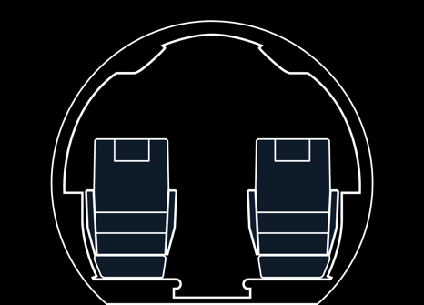


Cabin Cross-Section Comparison
G280
G400 G500 G600
G700 G800
 | G280 | G400 G500 G600 | G650ER G700 G800
Finished Cabin Height | 6 ft 1 in 1.85 m | 6 ft 2 in 1.88 m | 6 ft 3 in 1.91 m
Finished Cabin Width | 6 ft 11 in 2.11 m | 7 ft 7 in 2.31 m | 8 ft 2 in 2.49 m
G400 data is preliminary and subject to change

Slide 40
Cabin Environment Comparison
 | G280 | G400 | G500 | G600 | G700 | G800
Cabin Altitude at FL410 | 6,000 ft 1,829 m | 3,255 ft 992 m | 3,255 ft 992 m | 3,255 ft 992 m | 2,840 ft 886 m | 2,840 ft 866 m
Cabin Altitude at FL450 | 7,000 ft 2,134 m | 4,030 ft 1,228 m | 4,030 ft 1,228 m | 4,030 ft 1,228 m | 3,745 ft 1,141 m | 3,745 ft 1,141 m
Cabin Altitude at FL510 | N/A | 4,850 ft 1,478 m | 4,850 ft 1,478 m | 4,850 ft 1,478 m | 4,850 ft 1,478 m | 4,850 ft 1,478 m
Temperature Control Zones - Flight Deck and Cabin | 2 | 2 | 3 | 3 | 4 | 4
Cabin Air Quality | 100% Fresh with Ionization | 100% Fresh with Ionization | 100% Fresh with Ionization | 100% Fresh with Ionization | 100% Fresh with Ionization | 100% Fresh with Ionization
Lavatories – Toilet System | 1 - Vacuum | 1 or optional 2 - Vacuum | 2 - Vacuum | 2 - Vacuum | 2 - Vacuum | 2 - Vacuum
Water System Capacity | 10 gallons 37.9 Liters | 15 gallons 56.8 Liters | 30 gallons 113.6 Liters | 30 gallons 113.6 Liters | 40 gallons 151 Liters | 40 gallons 151 Liters
High Speed Connectivity | KA Band Optional | KA Band / Starlink Optional | KA Band / Starlink Optional | KA Band / Starlink Optional | KA Band / Starlink No-Charge | KA Band / Starlink No-Charge
G400 data is preliminary and subject to change

Slide 41
Technology and Systems Comparison
 | G400 | G500 | G600 | G700 | G800
Flight Deck | Symmetry | Symmetry | Symmetry | Symmetry | Symmetry
Engine | PWC PW812 | PWC PW814 | PWC PW815 | RR Pearl 700 | RR Pearl 700
Thrust Rating (each) | 13,486 lb 60.0 kN | 15,144 lb 67.4 kN | 15,680 lb 69.7 kN | 18,250 lb 81.2 kN | 18,250 lb 81.2 kN
Takeoff Thrust-to-Weight | 0.386 | 0.381 | 0.332 | 0.339 | 0.346
Flight Controls | Fly-by-wire w / Active Sidesticks | Fly-by-wire w / Active Sidesticks | Fly-by-wire w / Active Sidesticks | Fly-by-wire w / Active Sidesticks | Fly-by-wire w / Active Sidesticks
HUD with EVS | Single HUD Optional | Single HUD Standard | Single HUD Standard | Dual HUD Standard | Dual HUD Standard
Synthetic Vision | Optional | Standard | Standard | Standard | Standard
Automatic Braking System | Standard | Standard | Standard | Standard | Standard
G400 data is preliminary and subject to change
Notes:
To give you an idea of the benefits of commonality throughout this formidable fleet –
You’ll notice that every aircraft has an automatic braking system, our state of the art symmetry flight deck, and is controlled by fly by wire with active side sticks – an industry first. There’s also the option to have the heads up display and enhanced vision system installed into the G400 – the rest of the aircraft already have it as standard.

Slide 42
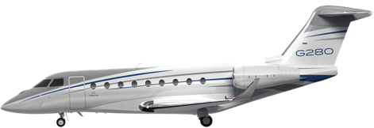



G280
High Speed Cruise: Mach 0.84
Range at Mach 0.84: 3,000 nm
Range at Mach 0.80: 3,600 nm
Challenger 3500
Citation Longitude
Praetor 600
High Speed Cruise: Mach 0.82
Range at Mach 0.82: 2,910 nm
Range at Mach 0.77: 3,400 nm
High Speed Cruise: Mach 0.82
Range at Mach 0.82: 3,282 nm
Range at Mach 0.80: 3,357 nm
High Speed Cruise: Mach 0.82
Range at Mach 0.82: 3,448 nm
Range at Mach 0.77: 4,018 nm

Slide 43
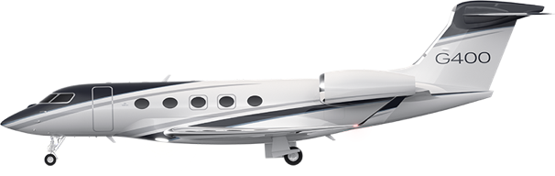



G400
High Speed Cruise: Mach 0.88
Range at Mach 0.88: 3,950 nm
Range at Mach 0.85: 4,200 nm
Falcon 2000LXS
Falcon 900LX
Challenger 650
High Speed Cruise: Mach 0.84
Range at Mach 0.84: 3,160 nm
Range at Mach 0.77: 3,809 nm
High Speed Cruise: Mach 0.84
Range at Mach 0.84: 3,628 nm
Range at Mach 0.77: 4,281 nm
High Speed Cruise: Mach 0.82
Range at Mach 0.82: 3,129 nm
Range at Mach 0.74: 3,745 nm

Slide 44
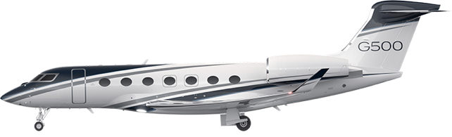



G500
High Speed Cruise: Mach 0.90
Range at Mach 0.90: 4,500 nm
Range at Mach 0.85: 5,300 nm
Falcon 7X
Falcon 6X
High Speed Cruise: Mach 0.85
Range at Mach 0.85: 4,930 nm
Range at Mach 0.80: 5,581 nm
High Speed Cruise: Mach 0.85
Range at Mach 0.85: 5,100 nm
Range at Mach 0.80: 5,500 nm
Global 5500
High Speed Cruise: Mach 0.88
Range at Mach 0.88: 5,340 nm
Range at Mach 0.83: 6,063 nm

Slide 45
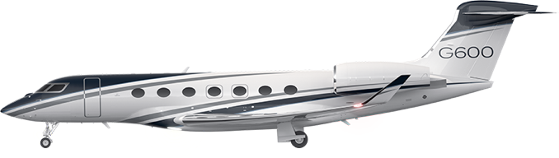


G600
High Speed Cruise: Mach 0.90
Range at Mach 0.90: 5,600 nm
Range at Mach 0.85: 6,600 nm
Falcon 8X
Global 6500
High Speed Cruise: Mach 0.85
Range at Mach 0.85: 5,421 nm
Range at Mach 0.80: 6,153 nm
High Speed Cruise: Mach 0.88
Range at Mach 0.88: 5,387 nm
Range at Mach 0.83: 6,780 nm

Slide 46
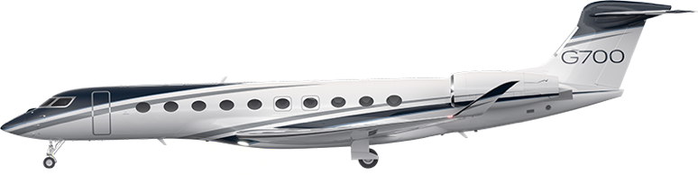


G700
High Speed Cruise: Mach 0.90
Range at Mach 0.90: 6,400 nm
Range at Mach 0.85: 7,700 nm
Falcon 10X
Global 7500
High Speed Cruise: Mach 0.90
Range at Mach 0.90: Unknown
Range at Mach 0.85: 7,500nm
High Speed Cruise: Mach 0.90
Range at Mach 0.90: 6,000 nm
Range at Mach 0.85: 7,700 nm

Slide 47
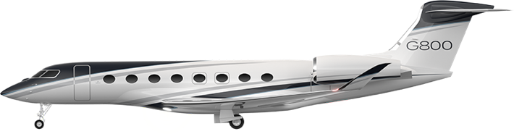
G800
High Speed Cruise: Mach 0.90
Range at Mach 0.90: 7,000 nm
Range at Mach 0.85: 8,000 nm
Falcon 10X
Global 8000
High Speed Cruise: Mach 0.90
Range at Mach 0.90: Unknown
Range at Mach 0.85: 7,500nm
High Speed Cruise: Mach 0.90
Range at Mach 0.90: 6,400 nm
Range at Mach 0.85: 8,000 nm

Slide 48
A Gulfstream for Every Mission
G800
8,200 nm Mach 0.85
G700
7,750 nm Mach 0.85
G600
6,600 nm Mach 0.85
G500
5,300 nm Mach 0.85
G400
4,200 nm Mach 0.85
G280
3,600 nm Mach 0.80
Notes:
Today, Gulfstream has the most formidable fleet of aircraft in the industry.
A Gulfstream for every mission – each aircraft setting a new standard for our industry in terms of safety, high-speed performance, environmental efficiency, and an unmatched cabin experience.
This fleet of aircraft is only possible through significant investments in:
Precision Manufacturing
Advanced Safety Technologies
Unmatched Cabin Experience
World Class Customer Support

