Slide 1

The high-quality alternative for
hourly engine maintenance coverage.
© 2020 Engine Assurance Program. All rights reserved.

Slide 2


Slide 3


EAP Delivers
EAP covers scheduled and unscheduled maintenance, including life-limited parts, LRUs, R&R, shipping, rentals, line maintenance, trend monitoring and catastrophic coverage while boasting a 99.99 percent dispatch reliability rate. EAP provides customers with increased residual value of their aircraft, enhanced customer service, and the highest ratio of rental engines to enrolled engines in the industry. EAP’s highly skilled and motivated team now includes an exclusive partnership with a rapid response field unit. Plus, most operators get full coverage with only 75 hours as the yearly minimum.

Slide 4
Why Choose EAP?
We recently polled our clients and asked them what they like best about EAP. We were delighted with the most popular answer: our customer service. Clients appreciated that they could call us directly, day or night, and get help immediately. It’s easy to work with EAP, and we work hard to keep it that way.
​
You can count on us to keep your engines flying, be of service and add value.
99.99
$34M
28
24/7
Percent Dispatch Reliability Rate
Engines, APUs and Parts in Inventory
Average Years of Experience
Support and AOG Assistance

Slide 5
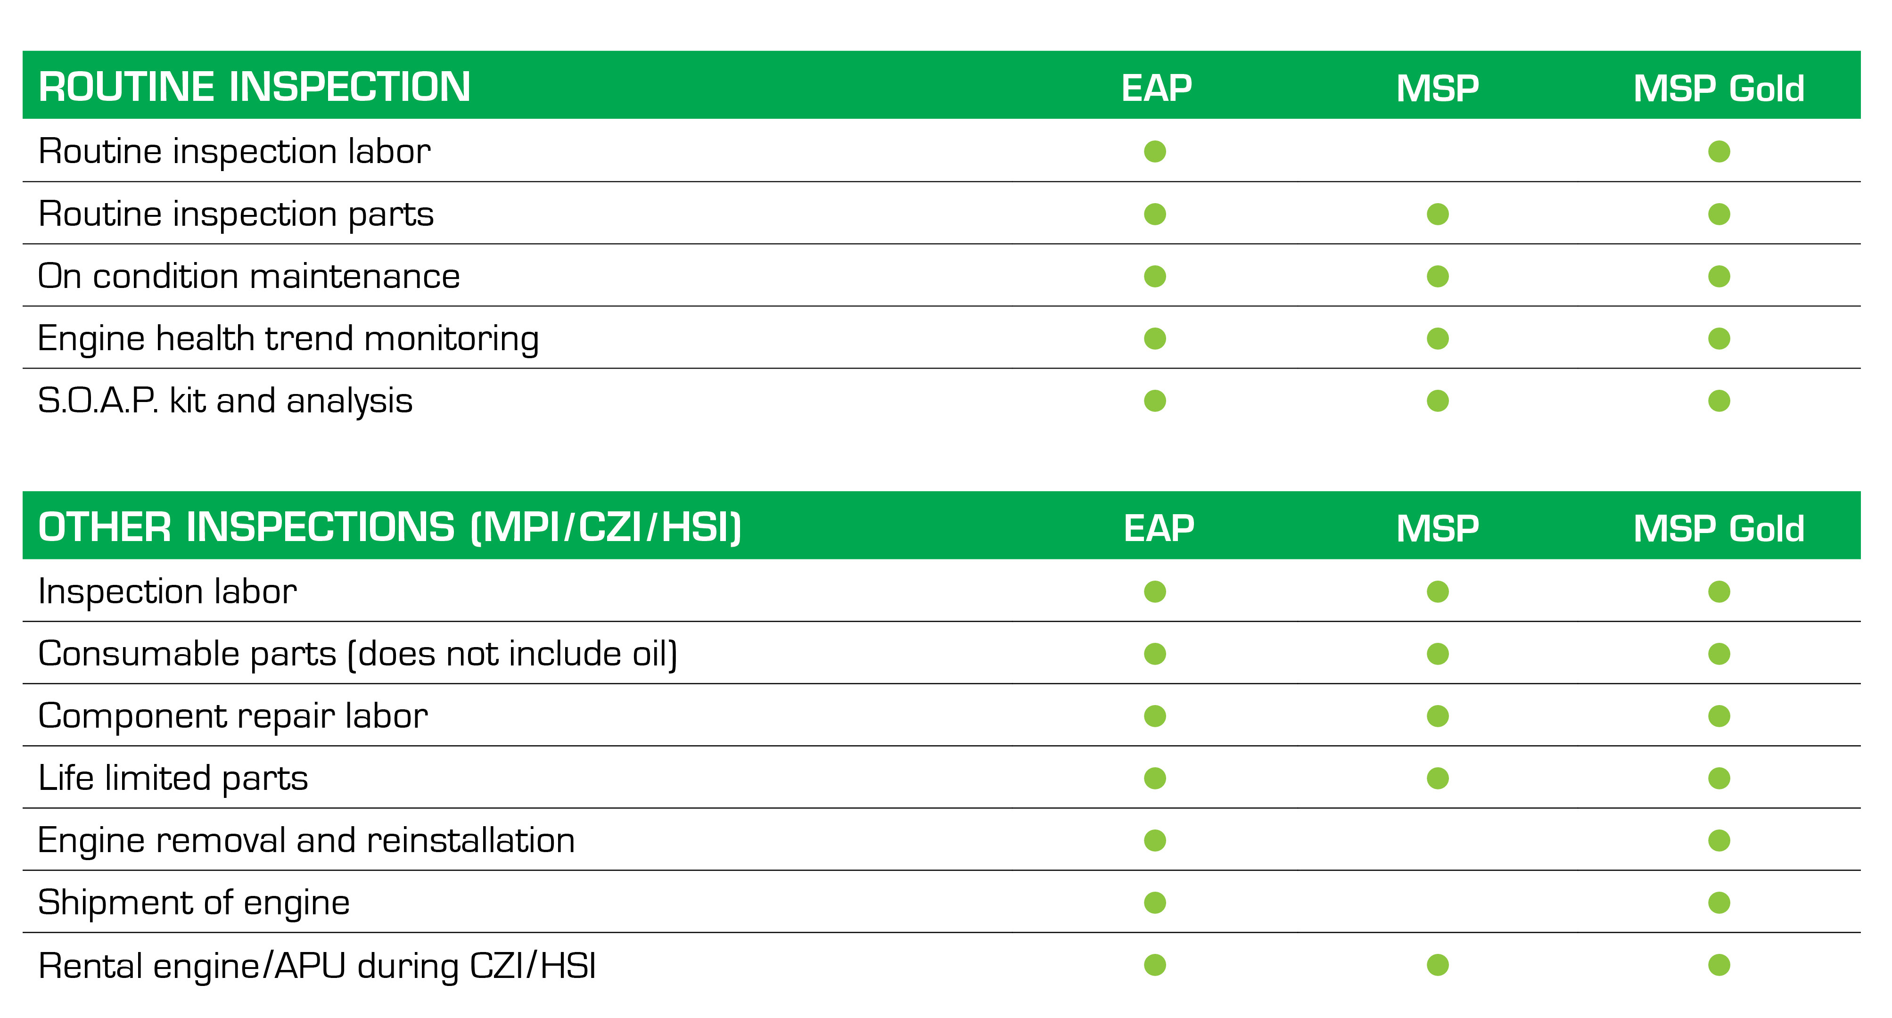
EAP Coverage Comparison
TFE731 engines and GTCP 36-100 and 36-150 APUs comprehensive engine coverage comparison to MSP and MSP Gold:

Slide 6
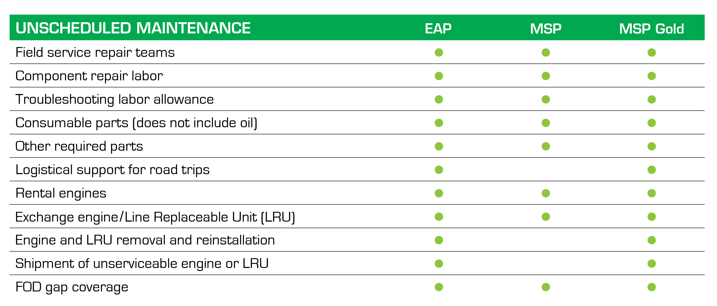
EAP Coverage Comparison
TFE731 engines and GTCP 36-100 and 36-150 APUs comprehensive engine coverage comparison to MSP and MSP Gold:

Slide 7
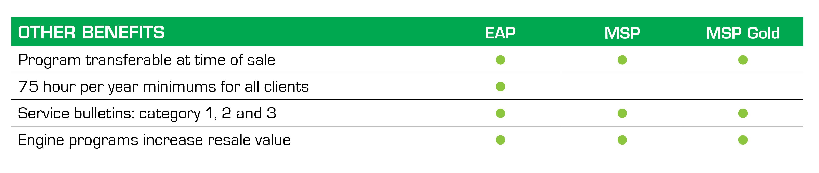
EAP Coverage Comparison
TFE731 engines and GTCP 36-100 and 36-150 APUs comprehensive engine coverage comparison to MSP and MSP Gold:
MSP and MSP Gold data from published Honeywell sources.

Slide 8
The Engines
EAP focuses specifically on older engine platforms and our single source solution offers many customer advantages. EAP covers all variants of the Honeywell TFE731 as well as many Pratt & Whitney, Rolls-Royce and General Electric engines and their APUs.
Honeywell TFE731-2 Lear 31 Falcon 10 Lear 35 | Honeywell TFE731-3 Falcon 50 Hawker 700 Astra 1125/SP Citation III/VI Lear 55 | Honeywell TFE731-4 Falcon 50-4 Citation VII | Honeywell TFE731-5 Falcon 900B/C Falcon 20-5 Hawker 800A/XP Hawker 850XP | Honeywell TFE731-20 Lear 40/XR Lear 45/XR | Honeywell TFE731-40 Astra SPX Falcon 50EX Gulfstream G100 Gulfstream G150 | Honeywell TFE731-50R Hawker 900XP | Honeywell TFE731-60 Falcon 900EX/LX
Honeywell CFE738-1-1B Falcon 2000 | Pratt & Whitney PW305 A/B Lear 60/XR Hawker 1000 | Pratt & Whitney JT15D-4 Citation II/SII | Pratt & Whitney JT15D-5 Beechjet 400 Citation V | Rolls-Royce AE3007C/C1 Citation X | Rolls-Royce AE3007A1E Legacy 600 | Rolls-Royce TAY 611-8 Gulfstream GIV/SP | General Electric CF34-3A/-3A1/-3A2 Challenger 601-1A/3A/3AER/3R
AND THEIR ASSOCIATED APUs
Notes:
an

Slide 9
The APUs
With EAP’s oversight and expertise, these APUs can stay in service longer and will help maintain your aircraft’s value:
GTCP 36-100
GTCP 36-150
T-62
RE100

Slide 10
New Additions
We will have recently these engines to our program.
Pratt & Whitney PW530A Citation Bravo | Pratt & Whitney PW535A Citation Encore | Pratt & Whitney PW535B Citation Encore+ | Pratt & Whitney PW545A/ RE100XL Citation Excel | Pratt & Whitney PW545B/ RE100XL Citation XLS | Pratt & Whitney PW545C/ RE100XL Citation XLS+ | Pratt & Whitney PW306A/ 36-150IAI Gulfstream G200 | Pratt & Whitney PW306C/ RE100CX Citation Sovereign
Rolls-Royce BR710A1-10/ RE220 Gulfstream GV | Rolls-Royce BR710A2-20/ RE220GX Bombardier Global Express/XRS
AND THEIR ASSOCIATED APUs

Slide 11


Before you renew your current plan or consider purchasing an aircraft, call 214.350.0877 or visit eap.aero/my-engine.
Let’s talk about our Broker Dealer referral program.
Customer focused. High-quality. Trusted resources.

